Slide 1
Engineering Economics (Excerptions)
Copyright Dr.Shahram Sharifi

Slide 2
Lecture 1
Time Value of Money
Copyright Dr.Shahram Sharifi

Slide 3
Time is Money!
❑ Money/Cash, like any other capital, has a value.
❑ We may not buy or sell money, but we lend or rent it.
❑ Like any other capital, there is a Cost for lending or renting money. It is called Cost of Capital or Interest Rate
Copyright Dr.Shahram Sharifi

Slide 4
Loans and Investments are regular terms for lending or borrowing money.
Cost of money is matched with the revenue that money generates or is expected to generate. So there should be a corresponding compensation/Interest.
This compensation/Interest adds to the value of money and money grows over time.
Copyright Dr.Shahram Sharifi

Slide 5
Growth, thus depends on
Initial Value of money
Interest Rate
Time
Copyright Dr.Shahram Sharifi

Slide 6
Logical Inferences about Time Value compensation
The bigger the initial value of the money, the bigger the accrued compensation /interest
The bigger the interest rate, the bigger the compensation /interest
The longer the time, the bigger the compensation/interest
Copyright Dr.Shahram Sharifi

Slide 7
Calculation of Interest for 1 year/ period
Initial value Interest Rate Interest E.O.Y
$1 0.1 1*0.1 $(1+0.1)
$1 i 1*i $ (1+i)
$100 i 100*i $100(1+i)
$P i P*i $ P(1+i)
*Note: E.O.Y :End of Year/period B.O.Y.: Beginning of the Year/period
Copyright Dr.Shahram Sharifi

Slide 8
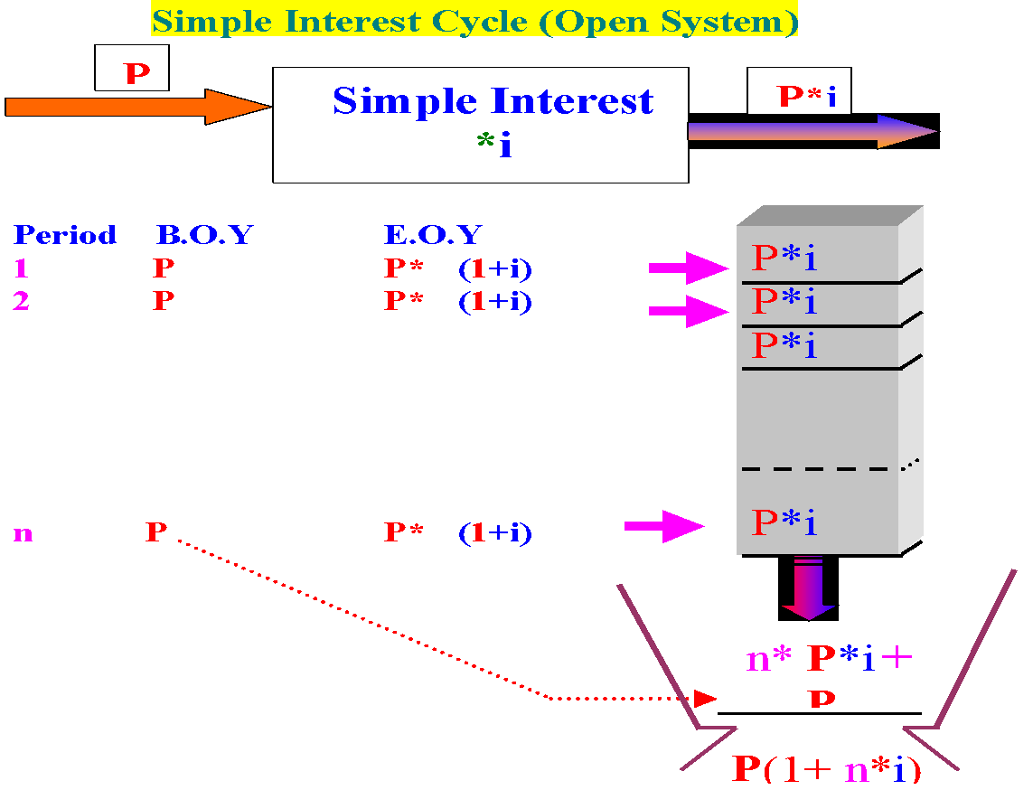
Copyright Dr.Shahram Sharifi

Slide 9

Compound Interest*(1+i)
Period Initial value Interest E.O.Y
1 P P* i P (1+i)
2 P (1+i) P (1+i)* i P (1+i) (1+i) = P (1+i)²
3 P (1+i)² P (1+i)²* i P (1+i)² (1+i)= P (1+i)³
…. ….. ………. …………. ……….
n P (1+i)^{n-1} P (1+i)^{n-1}* i P (1+i)^{n-1} (1+i)= P(1+i)^{n}
Copyright Dr.Shahram Sharifi

Slide 10
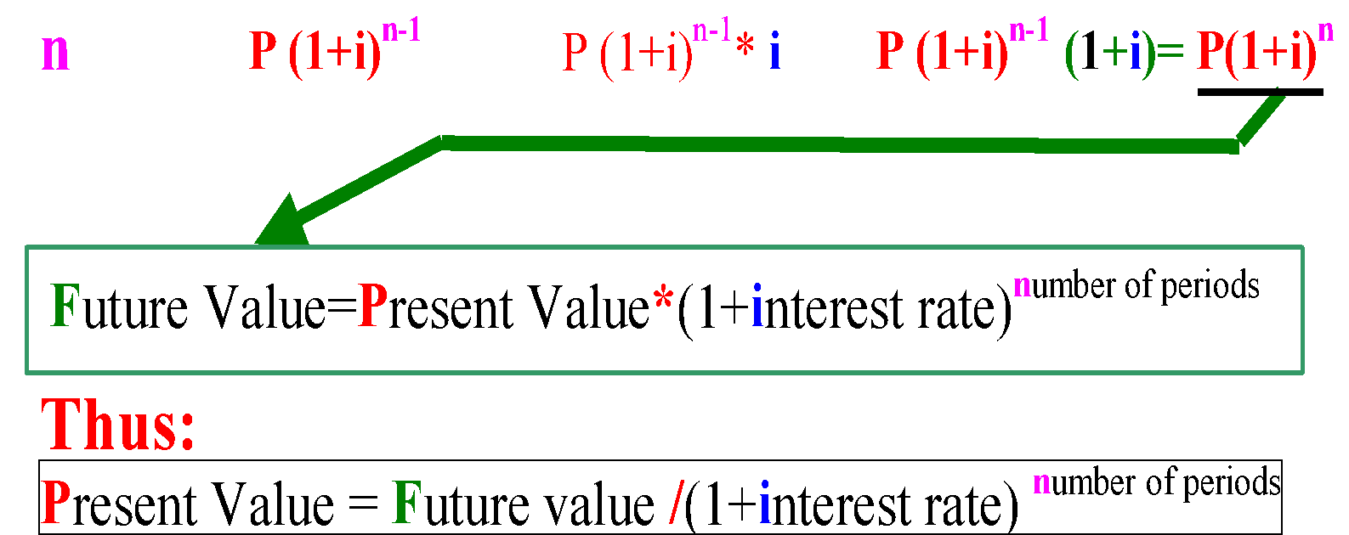
Fundamental Relationship
Period B.O.Y value Interest E.O.Y balance
Copyright Dr.Shahram Sharifi

Slide 11
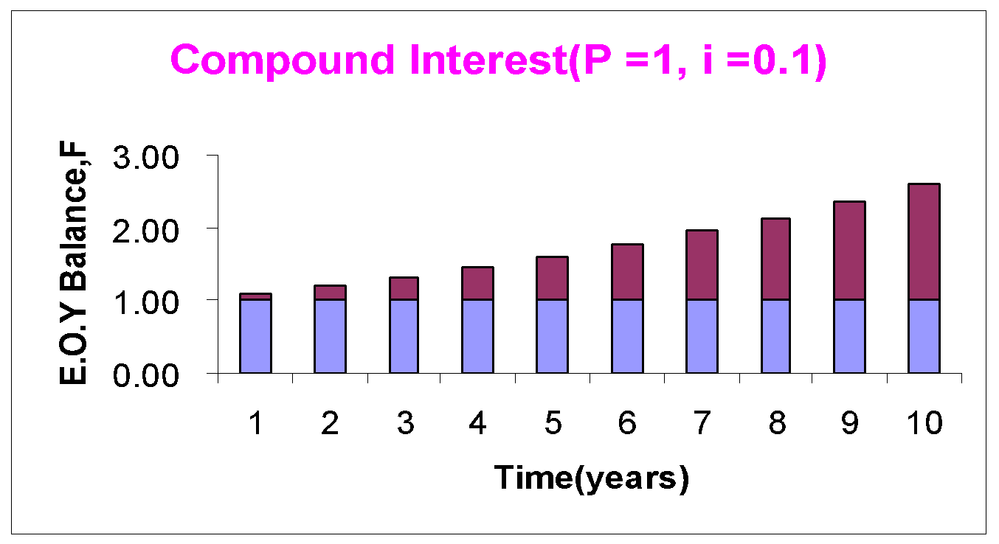
Graphical representation of simple and compound interest systems
P*i
P + n (P*i)
P
0 1 2 3 4……Time(Year)
Copyright Dr.Shahram Sharifi

Slide 12
Examples
Simple Interest: you mow the lawn in the End Of each Year
Compound Interest: You let it grow (at g % growth rate)
Let's say population grows at a rate of 0.2% in Canada. Is it Simple Interest or Compound interest?
Copyright Dr.Shahram Sharifi

Slide 13
Cash Flow Analysis, Concept of Equivalence
Copyright Dr.Shahram Sharifi

Slide 14
As shown in the compound interest formula and diagrams, the further we move away from today (t=0) toward the future, the bigger the money becomes i.e. money grows. In other words, Future value becomes larger as n increases.
Nevertheless, the identification of the initial money i.e. Present Value is maintained.
Copyright Dr.Shahram Sharifi

Slide 15
Equivalence
No matter what the calculated value of money is in Future in ANY point of time, the value of all those calculated Future values is the same at a(ny!) point of time (e.g. at t = 0).
Look at the next slide!
Copyright Dr.Shahram Sharifi

Slide 16
$100
$100
$100
$100
$146
$133
$121
$110
0 1 2 3 4 ……Time(Year)
As shown in the figure above, the value of all the different calculated
Future values is $100, when considered for the same point of time (e.g. t = 0)!
Copyright Dr.Shahram Sharifi

Slide 17
Definition of Equivalence
Given 10% interest rate:
$100 today is EQUIVALENT to $110 a year later, $121 two years later, $133 three years later, $146 four years later, and ……… $100(1.10)^{n}, n years later and VICE VERSA!
Copyright Dr.Shahram Sharifi

Slide 18
Freedom of motion
As a direct result of concept of Equivalence, Cash Flow can move back and forth alongside the Time line, just by applying the appropriate decrease or increase according to the number of periods traveled in time.
Copyright Dr.Shahram Sharifi

Slide 19
Comparing Cash Flows
Thus far, we have dealt with one single sum of money and its equivalents in different time periods (e.g. years). And we concluded that this sum could move freely alongside the time line back and forth by appropriate expanding or downsizing. The single sum, thus changes its size (i.e. value) according to the position it adopts on the time line.
Copyright Dr.Shahram Sharifi

Slide 20
Multiple sums
What if instead of one single sum we had two or more sums of money, namely Cash Flows?
The critical question is how can we compare two or more sums on the time line?
The answer is that:
Copyright Dr.Shahram Sharifi

Slide 21
Multiple sums
The reasonable way to compare two or more Cash Flows on the time line, is to get them in the very same point of time, whatsoever!
Copyright Dr.Shahram Sharifi

Slide 22
EXAMPLE 1
You have deposited $1000, in 1998, $ 500 in 2000 and $200 in 2001 in a GIC account in the Royal Bank. Assume the $ 200 and $ 500 that you deposited in 2000 and 2001, were the balance of a GIC account opened in 1998 in Bank of Montreal. Interest rate is 5%.
How much money were you worth in the 1999? *Timings are on the End Of Year basis
Copyright Dr.Shahram Sharifi

Slide 23
Solution by direct calculation
t=0
98 99 00 01 02 Time(yrs)
1000(1.05)¹
500(1.05) ⁻¹
200(1.05) ⁻²
$1707.6
Copyright Dr.Shahram Sharifi

Slide 24
Compound Factors
So to calculate the Future value of $1000 for year 1999, (1 year distance), we just need to MULTIPLY that factor by 1000.If we want to travel BACK to the Present, we have to DIVIDE by the corresponding factor. We call the first Compound amount factor and the second one, Present value factor.
F=P (1+i)^{n} F/ P =(1+i)^{n}
(Future value of $P) (FutureValue of $1)
P =F/(1+i)^{n} P/ F =1/(1+i)^{n}
(Present value of $F) (Present Value of $1)
Copyright Dr.Shahram Sharifi

Slide 25
Cash Flow Systems
Copyright Dr.Shahram Sharifi

Slide 26
Annuity/Uniform Series Example2
John McEnroe wants to buy a Honda for $40,000.He wants to know how much he should deposit in his bank account annually(at the End Of Year), in order to be able to buy the car in 4 years? The interest rate for his account is 10%. (Assume that price of the car remains constant over time).
How much is A?
Copyright Dr.Shahram Sharifi

Slide 27
How much is A?!
A(1.1)³ +
A(1.1)²
A(1.1)
A A A A
A{1+(1.1)+ (1.1)² +(1.1)³}=$40, 000
0 1 2 3 4……… Time(Year)
$40,000
Copyright Dr.Shahram Sharifi

Slide 28
we can easily calculate A from equation above. Bt let's solve this problem in general case where interest rate is i and Future value F and No. of years "n"
Copyright Dr.Shahram Sharifi

Slide 29
Finding the value of annuity
F=A{1+(1+i)+(1+i)²+…+(1+i)^{n-2} + (1+i)^{n-1}} (1)
F=A[1 + x+ x²+….+ x ^{n-2} +x ^{n-1} ] (2)
F.x=A[ x+ x²+x³+…+ x ^{n-1} + x ^{n} ] (3)
F.x -F = A[x ^{n}-1] (3) - (2)
F(1+i)-F= A[(1+i) ^{n} -1]
F = A[(1+i) ^{n} -1]/ i
Copyright Dr.Shahram Sharifi

Slide 30
Never-ending Annuity!
What if the annual Cash flows never end?
A A A A A A A A A=10,000*i
0 1 2 3 4 5 6…………… 50 …..infinity
Copyright Dr.Shahram Sharifi

Slide 31
Never-ending Annuity
Let's say you have got $ 10,000 line of credit and you have spent all of it. In each period, you pay only the interest. If this situation lasts "FOREVER". Does the bank EVER gets its $10,000 principal back?
NO!
Copyright Dr.Shahram Sharifi

Slide 32
Never-ending Annuity
At the End Of each Period you pay the interest P*I so as not to let your Principal Loan compound. Bank is never going to receive its principal, since you Pay the Interset "FOREVER". Therefore, the Present Value of the Neverending uniform series would be the same as P by Equivalence.
Copyright Dr.Shahram Sharifi

Slide 33
Never-ending Annuity
If you are not yet convinced refer to the formula for Ordinary Annuities and let n, approach infinity. You'll get the same answer!
Thus we can write:
A=P*i
Therefore the present value of
a never-ending annuity would be:
P = A/i
Copyright Dr.Shahram Sharifi

Slide 34
Arithmetic Gradient Series of Cash Flows
When the cash flows increase by a constant amount G each period (e.g. maintenance cost of machine), we have a Gradient Series.
As shown in Figure below, an inclined line with slope G. Note that the Gradient occurs at the E.O.Y. 2
Copyright Dr.Shahram Sharifi

Slide 35
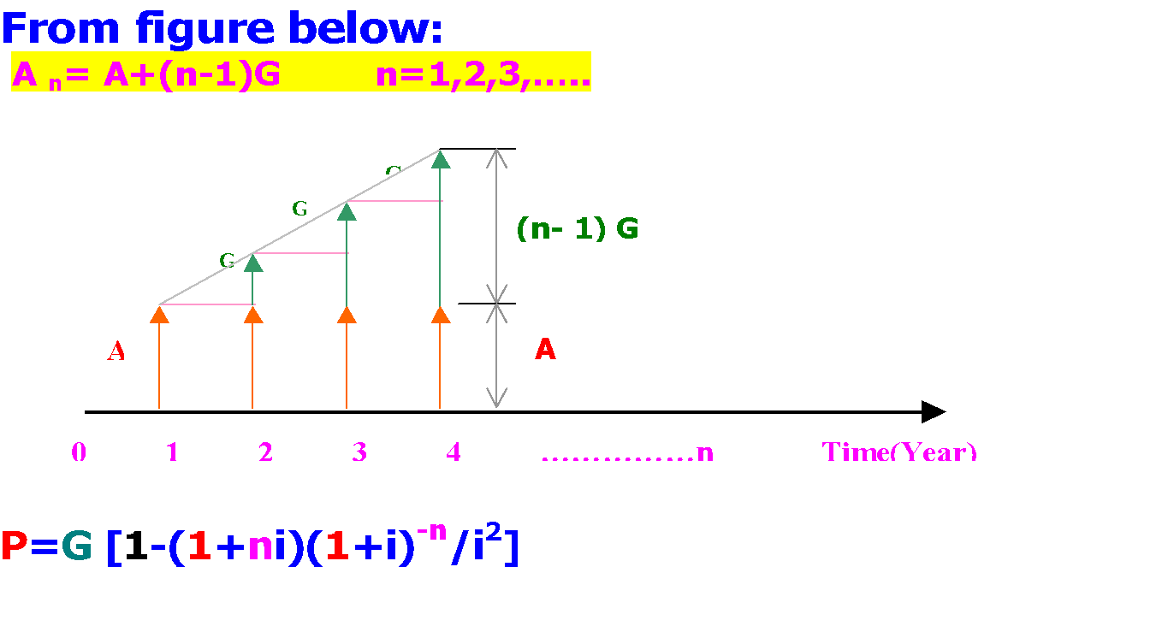
Copyright Dr.Shahram Sharifi

Slide 36
Geometric Gradient Series of Cash Flows
In this series the Principal value is increased by a constant Percentage to represent the second Cash Flow and so on. Thus each Cash Flow is by a Constant g times its immediate previous Cash Flow.
Look at the next slide!
Copyright Dr.Shahram Sharifi

Slide 37
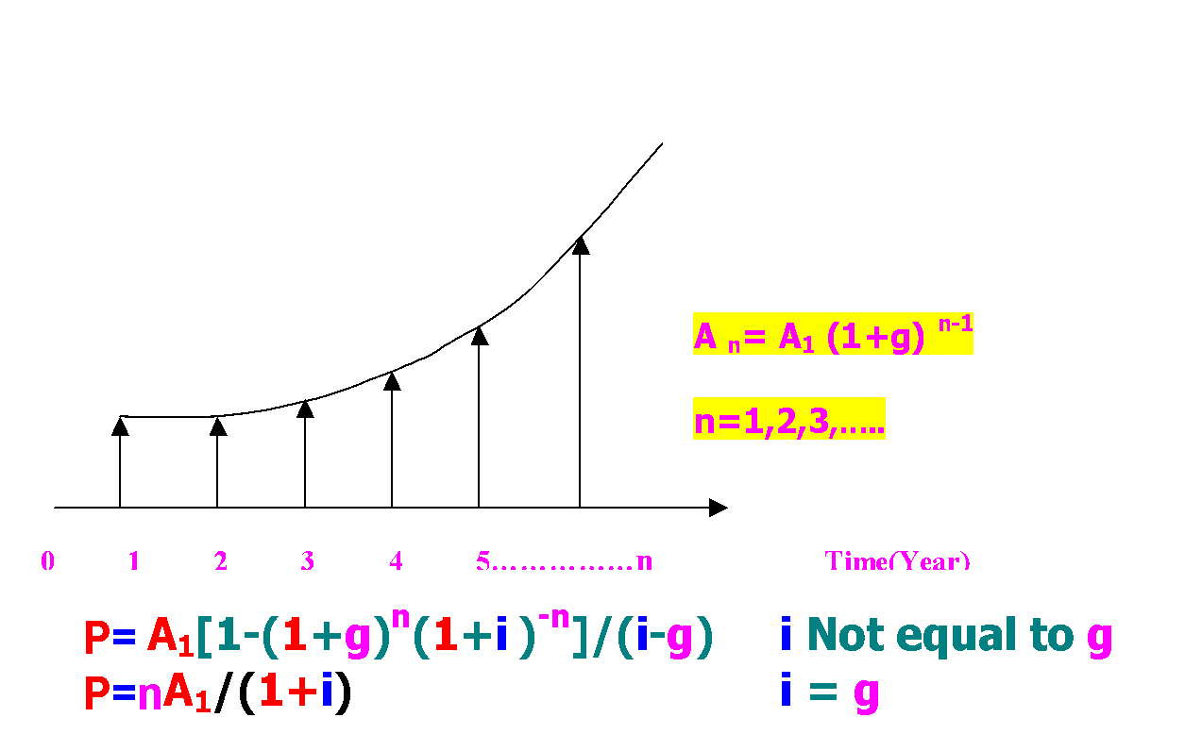
Copyright Dr.Shahram Sharifi

Slide 38
Cash In Flow(+), Cash Out Flow(-)
In Cash Flow Diagram we show Inputs (Income) to the system with Positive Cash Flows, i.e. Cash In Flows- and Outputs (disbursements) with Negative Cash Flows, i.e. Cash Out Flows.
So in Calculations, we find the algebraic sum, i.e. account for signs (+ or -), rather than arithmetic sum. So we end up with Net Values. If we calculate the Present Values of the Series of Cash In Flows and Out Flows, we'll find The Net Present Value, NPV.
Copyright Dr.Shahram Sharifi

Slide 39
NPV= 427(1+0.1)⁻¹ +114(1+0.1) ⁻⁵ -587(1+0.1) ⁻⁴ -123(1+0.1) ⁻⁶
NPV= -11.39
+$427
+$114
0 1 2 3 4 5 6 Time
-$123
NPV= -$11.39
-$587
Copyright Dr.Shahram Sharifi

Slide 40
Nominal vs Effective rates
Copyright Dr.Shahram Sharifi

Slide 41
Nominal and effective Interest Rate
What is the value of $1 in one YEAR, at a nominal Annual Interest Rate of 12%, compounded semi- annualy (Every Six months)?
Copyright Dr.Shahram Sharifi

Slide 42
So far we assumed the compounding and Interest period both being a YEAR . But what if money compounds more frequently i.e. in shorter time periods than a YEAR?(eg. monthly). If so then what would be the Actual/Effective Interest Rate per year?
Copyright Dr.Shahram Sharifi

Slide 43
APR=Annual Percentage Rate =Nominal Annual Rate
Periodic Rate = APR/No. of Periods in a YEAR
EAR=Effective Annual Rate=Actual Rate
Copyright Dr.Shahram Sharifi

Slide 44
?=EAR
(1+?)
*(1+.06)
*(1+.06)
$ 1
0 1 2 3……………n Time (6 months)
By Equivalence Principle we can write:
0 ➔2 = 0 ➔1 *1➔2
1+EAR =(1+.06)* (1+.06)
1+EAR =(1+.12/2)*(1+.12/2)
In General
1+EAR =(1+i/m)*(1+i/m)……... * (1+i/m)= (1+i/m)^{m}
OR:
1+EAR=(1+APR/m)^{m} EAR=(1+APR/m)^{m}-1
Copyright Dr.Shahram Sharifi

Slide 45
Notes:
If compounding Rate is less than 1 year EAR>APR
If compounding Rate is equal to 1 year EAR=APR
If compounding Rate is equal to 1 year
EAR??????????APR......!!!!
Most loan rates such as car loans, credit card loans,Line of credits,House mortgaes, etc are quoted in terms of APR but usally compounded more frequently(eg.monthly). So the actual rate charged i.e. EAR is more!
Copyright Dr.Shahram Sharifi

Slide 46
Example1
Catherine lends money to her clients at the (periodic) rate of 1% per week! What are the Nominal and Effective annual intrest rates that she charges?
Solution:
APR= Annual Nominal Rate=1%*52=52%
EAR=(1+0.01)⁵²-1=0.68=68% !
Copyright Dr.Shahram Sharifi

Slide 47
Example 2:
If EAR on a car loan that is compounded quarterly, is computed to be 20%, what has been the APR declared initially?
Solution
1+EAR=(1+APR/m) ^{m}
1.20= (1+APR/4) ⁴
➔Periodic(Quarterly)rate =18.65% /4
^{=4.66%}
Copyright Dr.Shahram Sharifi

Slide 48
Effective annual rates for different compounding periods
Compounding period Compounding frequency EAR
Year 1 12.0000%
Quarter 4 12.5508%
Month 12 12.6825%
Week 52 12.7340%
Day 365 12.7474%
Hour 8760 12.7495%
Minute 25,600 12.7496%
……. ………. ……………
Infinitesimal point of time infinite 12.7496%
Copyright Dr.Shahram Sharifi

Slide 49
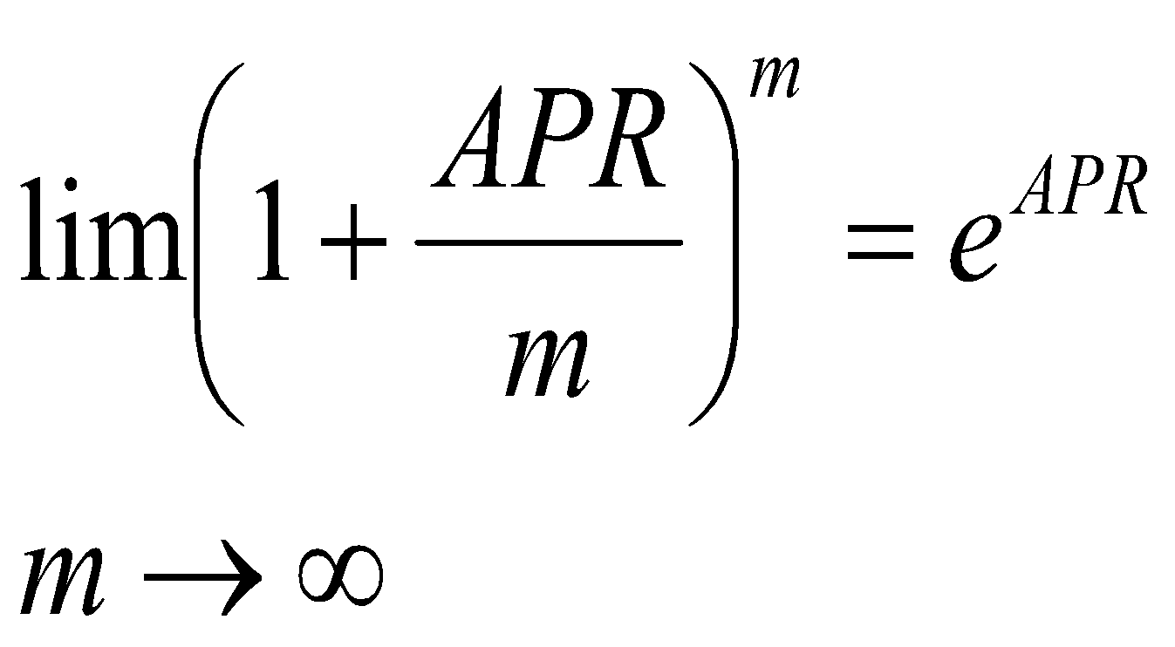
When we look at the previous table, we see that as compounding period becomes smaller and smaller and no. of times compounded (compoundimg frequency) becomes bigger and bigger, the Effective Annual Rate becomes bigger but its increase slows down with increase of compounding frequency.We can conclude that EAR is nearing a limit.That limit is :
This is called the continous compounding interest rate.We conclude that continous compounding rate is the upper bound of all compounding rates.
Copyright Dr.Shahram Sharifi

Slide 50
Changing Interest rates
Thus far, one of the basic implicit assumptions, was that Interest rate remains constant during the Cash Flow period.What if the interest rate changes from period to period due to market volatility, macroeconomic instability, inflation, monetary policy, risk,etc ?
Copyright Dr.Shahram Sharifi

Slide 51
*(1+i₃)
F= ?
*(1+i₂)
*(1+i₁)
$1
0 1 2 3 4 5…… n time
By Equivalence:
0➔3 =0➔1 *1➔2 *2➔ 3
F=(1+i₁) *(1+i₂) *(1+i₃) (1)
So we conclude that Future value formula is special case of this s formula. Actually if you set i₁= i₂= i₃=….=i_{n}=i
in equation (1), you will get the former formula F=(1+i)^{n}
Copyright Dr.Shahram Sharifi

Slide 52
Equivalence in practice
In practice we can identify three types of equivalence
1-Mathematical Equivalence: which was covered in lecture 2 and was a mathematical relationship between Present Value and its equivalent values in different points of time in Future.
2-Equivalence by decision making: It depends on the subject to accept a value in Future in exchange for some value today.
3-Market Equivalence: assumes that there is a money market where you can lend or borrow money at the same cost. In other words, you can exchange one cash flow for another at zero cost. For an individual, market equivalence does not exist. While for large companies we can assume that market equivalence exists.
Copyright Dr.Shahram Sharifi

Slide 53
Comparison of Alternatives
Copyright Dr.Shahram Sharifi

Slide 54
Projects as investments opportunities
The essential idea of investing, is the exchange of resources now for an expected flow of benefits in future. Projects are assumed as investment opportunities. Not all the investments should or can be taken. They should not be taken either because there are better ways of spending the money, (i.e. opportunity cost) or because another project is more profitable among the others. They can not be taken because of the limited resources, we need to prioritize between projects.
Copyright Dr.Shahram Sharifi

Slide 55
Relations among Projects
Projects are either:
I. Independent :The costs and benefits of one are independent of that of the other. So treat each project Independently on its own merits
II. Mutually exclusive: If choosing one excludes all the others. So choose among the "best" among them.
III. Related but not mutually exclusive: (Neither I. nor II. above!)The expected costs and benefits of one depend on the other.
Copyright Dr.Shahram Sharifi

Slide 56
For any pair of two "Related but not mutually exclusive Projects" A and B, we have 2²=4 "SETS" of choices, including "Do nothing" as following:
1. Do nothing
2. Do A
3. Do B
4. Do Both
Copyright Dr.Shahram Sharifi

Slide 57
We measure the value/worth of a project at i= MARR. It is the minimum rate of return for investment that company or the investors require and consider as Cost of leasing their capital/money. Where compound interest calculations are involved the methods of measuring the Investment worth are referred to as Discounted Cash Flow- (DCF) Methods. Then MARR is the discount rate by which the cash flows (+/-) of an investment project are discounted.
Copyright Dr.Shahram Sharifi

Slide 58
Concept of Financial Evaluation of Alternative Project
$100
$100
$100
$100
$146
$133
$121
$110
0 1 2 3 4……Time(Year)
Remember the above figure? It showed the concept of (Mathematical) Equivalence. It says that for example $133 [i.e. 100(1+10%)³ ], in 3 years at an interest rate i=10% is Equivalent to $100 today (t=0)
Copyright Dr.Shahram Sharifi

Slide 59
if you have invested your money at 10% in 3 years, you expect to "receive" $133 in "return". What if you received more than 133?! It simply implies that your interest rate (Rate of Return) has been more than expected. Alternately if you received less in return, it means that your rate of return has been less than you expected.
Now since comparing cash flows in different times (e.g t=0 v.s t=3) is not always as easy as above example, we better compare them at the same time. How about comparing them at Present time?
Copyright Dr.Shahram Sharifi

Slide 60
In the previous figure, our $100 investment would be $100 at Present time (t=0), so it Present Value is: PV₁= $100
On the other hand the $133 receipt in year 3 would be the same amount $100 at Present time thus:
PV₂=133/(1+01³)=$100 (due to
Equivalence)
Thus:
Net Present Value=NPV=-PV₁+ PV₂=
$-100+$100=$0
Copyright Dr.Shahram Sharifi

Slide 61
Since we have received neither more nor less (i.e $0) it implies that we have got exactly the Equivalent amount in return (Equivalent by an interest rate i=10%), neither more nor less
Therefore:
We had received more if NPV>0
We had received less if NPV<0
Copyright Dr.Shahram Sharifi

Slide 62
So if project as an investment opportunity has NPV>0 it is worth it otherwise it is not. But what is the specific interest rate by which we can discount the Cash Flows of a project and check its NPV?! Every Investor or company has a Minimum Attractive Rate of Return-MARR, for their own, below which they do not invest in the Projects. For example, in the above figure, we assumed MARR for some company was 10%.
Copyright Dr.Shahram Sharifi

Slide 63
Result 1:Net Present Value of any money invested at MAAR is Zero![Invested in the sense that you deposit cash in a bank at an interest rate, then you will be paid back according to that interets rate which would be your MARR.]
Result 2:We are always comparing alternative projects at MARR.
Result 3: Among several Alternative Projects we select the one with the Greatest Positive NPV.
However we should notice that in some problems or real life situations, due to some special reasons (such as public projects with no tangible inflow,, Equal benefits in different alternatives (i.e. cash inflows being all the same in different alternatives) , having no choice other than going for one of the alternatives), etc, we might deal only with costs as negative cash flows in the absence of profits as positive cash flows
Copyright Dr.Shahram Sharifi

Slide 64
As a result all the alternatives end up with negative NPV. In these situations we choose the alternative with Greatest NPV (i.e. the lowest negative absolut value!)
Result 4:(Generalization of Result 3) Among several Alternative Projects, we always select the one with the Greatest NPV (Positive or Negative with regard of the sign)
Minimum Attractive Rate of Return-MARR
MARR= Required Rate of Return =(Company's) Cost of Capital = Opportunity Cost
Copyright Dr.Shahram Sharifi

Slide 65
Issue :
In the discussion above on Financial Evaluation of Alternative Projects, we said that it was better to compare the receipts and disbursements all at the "same time" , but the "same time" does not necessarily imply Present time (t=o). It could be any other "same time" including Future or Annual. So we can also compare the Future Value of Cash Flows or Uniform series of Annual Receipts and or Disbursements. We also call these two other methods Future Worth and Annual Worth.
Copyright Dr.Shahram Sharifi

Slide 66
Note1:
Annual Worth is not necessarily yearly, it could be any periodic uniform series of Cash Flows.
Note 2:
Since Present, Future and Annual Values are Equivalent, they should lead to the same recommendations and Equivalent results on Alterbative Project selection.
Copyright Dr.Shahram Sharifi

Slide 67
Evaluation and selection among Investment Alternatives
When dealing with Independent Alternatives: Compare them with MARR i.e. evaluate the PW(NPV) at the rate of MARR and choose ALL having a positive PW(NPV).
When dealing with Mutually Exclusive Alternatives:Select ONLY the one with the greatest positive PW(NPV)
When dealing with Related but not Mutually exclusive : Alternatives: Transform them to 2^{n} Mutually Exclusive options and follow the above rule.
Note: In the event that the projects’ benefits/inflows are not stated because all alternatives have the same equal cash flow of benefits or benefits/ inflows are tangibly nonexistent but we have to select one anyways( e.g. Public Projects), we will choose the one with the lowest Present Cost (i.e. Greatest PW given the sign)

Slide 68
Methods of measuring Investment Worth of a project
1) Present Worth/PW (i.e. NPV)
2) Annual Worth/AW
3) Future Worth/FW
4) Internal Rate of Return
5) External Rrate of Return
6) Cost –Benefit ratio
7) Pay back Period
8) Capitalized Worth
We have already got to know some of the above methods!
Copyright Dr.Shahram Sharifi

Slide 69
Example:
You have been offered to buy a machine for $800,000. If you can lease your machine at $20,000 per year before you sell it at $550,000 at E.O.Y 2, is it worth it? MARR =12% per year
Solution:
C₀ = $-800,000 Initial cost
C₁ = $550,000 Selling price at E.O.Y 2
CF= $20,000
Discounting future Cash Flows we have:
PV=20,000(P/A,12%,2)+550,000(P/F,12%,2)=20,000*1.6901+550,000*
0.79719=776,474
NPV= -800,000+776,474=-23,525<0
Copyright Dr.Shahram Sharifi

Slide 70
Since NPV is negative we do not go for the offer (beacuse benefits are also stated!).
Once you have the Net Present Value (PW), Annual Worth(AW) and Future Worth (FW) are related by the following formulas:
FW=NPV(F/P,12%,2) and AW=NPV(A/P,12%,2)
Thus those methods should also show that it is not worth it. Check it out!
Copyright Dr.Shahram Sharifi

Slide 71
Dealing with Projects of unequal lives
Copyright Dr. Shahram Sharifi

Slide 72
Example
Project Initial Cost NPV Service life
A -$25,000 -70,300 15
B -$15,000 -57,600 10
Although NPV(A)<NPV(B) we should note that B lives 10 years while A lasts 15 years. Presumably we expect a 15 year old Project cost more than a 10 year old. So to be accurate we have to size the two projects and then make conclusion.
Copyright Dr. Shahram Sharifi

Slide 73
Repeated lives method
Repeat each project for that time interval equal to the Least Common Multiple (LCM) of the two projects and consider the cash flows of each for that period.
A
B
0 5 10 15 20 25 30 years
Copyright Dr. Shahram Sharifi

